Slide 1
Modularized Tool for Quantum/ Quantum Enhanced
Machine Learning
Ezinwanne Ozoani
Date 26/03/21
Notes:
I Made a modularised ….. For engineers,scientist and other quantum enthists
In this presentation will dive further into the elements of the quantum tool
But first we a quick quantum background as well as the elements of the tool and

Slide 2
Introduction
Introduction & background
The Circuits
Data Encoding
Quantum
Run
Classical
Run
Results
Future
Work
Conclusion
Why ❓❓
Trinity College Dublin, The University of Dublin

Slide 3
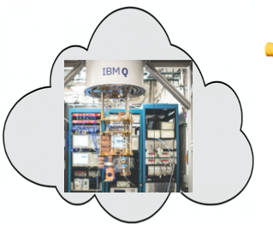
Introduction
Introduction & background
The Circuits
Data Encoding
Quantum
Run
Classical
Run
Results
Future
Work
Conclusion
Why ❓❓
👍
Trinity College Dublin, The University of Dublin
Notes:
While there are a lot of research and even open source tools and communities like IBM qiskit
Where anyone can access and program on a quantum computer through the cloud
However the barrier of entry for software engineers and ML scientist’s is still quite high

Slide 4

Introduction
Introduction & background
The Circuits
Data Encoding
Quantum
Run
Classical
Run
Results
Future
Work
Conclusion
Why ❓❓
👍
👎
Trinity College Dublin, The University of Dublin
Notes:
The vast nature of Quantum computing
Mostly in research papers → theoretical
Forums
Spread out
The higher learning “hill” of more theoretical physic based papers
Bring all knowledge together in a somewhat central place

Slide 5
Introduction
Introduction & background
The Circuits
Data Encoding
Quantum
Run
Classical
Run
Results
Future
Work
Conclusion
Aim → Tackling the problem
Trinity College Dublin, The University of Dublin
Notes:
My aim is to tackle this problem

Slide 6
Introduction
Introduction & background
The Circuits
Data Encoding
Quantum
Run
Classical
Run
Results
Future
Work
Conclusion
Aim → Tackling the problem
Provide a tool / training ground better understand quantum machine learning
Trinity College Dublin, The University of Dublin
Notes:
** After the fist point **
Create a more inviting approach for more to build on
** After 2nd paragrapH**
We will create modular options to swap in the different kinds of Machine learning and searching circuits
Also How those circuits will handle that data

Slide 7
Introduction
Introduction & background
The Circuits
Data Encoding
Quantum
Run
Classical
Run
Results
Future
Work
Conclusion
Aim → Tackling the problem
Provide a tool / training ground better understand quantum machine learning
From the Machine learning algorithms we know
Classification - SVM KNN
To Govers algorithm
Trinity College Dublin, The University of Dublin
Notes:
Not only will the modularised tool provide a way to implement ML swappable circuits but we will also ...

Slide 8
Introduction
Introduction & background
The Circuits
Data Encoding
Quantum
Run
Classical
Run
Results
Future
Work
Conclusion
Aim → Tackling the problem
Provide a tool / training ground better understand quantum machine learning
From the Machine learning algorithms we know
Classification - SVM KNN
To Govers algorithm
How to handle data
How to access Quantum Computers
Trinity College Dublin, The University of Dublin
Notes:
Talk about how to make use of classical data with quantum computer
And now to access the quantum computers itself

Slide 9
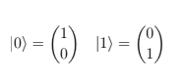
Background
Introduction & background
The Circuits
Data Encoding
Quantum
Run
Classical
Run
Results
Future
Work
Conclusion
Quantum gates
Trinity College Dublin, The University of Dublin
Notes:
In order to do all this
We will need to be familiar with quantum gates and operations as they will be the main components of our quantum circuits

Slide 10
Background
Introduction & background
The Circuits
Data Encoding
Quantum
Run
Classical
Run
Results
Future
Work
Conclusion
Quantum gates
Qubit: short for quantum bit, is the smallest unit of information in a quantum computer.
They can be represented as a vector
|0> is used to represent a qubit in state zero and |1> to represent a qubit in state one.
Trinity College Dublin, The University of Dublin
Notes:
Like in classical computer a bit is the smallest unit
Similarly in quantum we have qubits
They can be expressed in vector forms

Slide 11
Background
Introduction & background
The Circuits
Data Encoding
Quantum
Run
Classical
Run
Results
Future
Work
Conclusion
Quantum Definitions
Trinity College Dublin, The University of Dublin
Notes:
We will also need to know some definitions

Slide 12
Background
Introduction & background
The Circuits
Data Encoding
Quantum
Run
Classical
Run
Results
Future
Work
Conclusion
Quantum Definitions
Superposition: Unlike a classical bit which can be in either state |0> or in state |1> a qubit
On the other hand can be in state |0> and state |1>at the same time with some probability of being in either state.
Trinity College Dublin, The University of Dublin
Notes:
Think Schrödinger’s cat, which can be dead or alive with some probability. Opening the box is “measuring” the state of the cat.
Englanglemnt: In this entangled quantum system if we measure the first qubit and it turns out
to be in state |0i, the second qubit would automatically collapse to state |0i
as well, similarly if the first qubit is measured to be in state |1i, the second
qubit would immediately collapse to |1i as well.

Slide 13
Background
Introduction & background
The Circuits
Data Encoding
Quantum
Run
Classical
Run
Results
Future
Work
Conclusion
Quantum Definitions
Superposition: Unlike a classical bit which can be in either state |0> or in state |1> a qubit
On the other hand can be in state |0> and state |1>at the same time with some probability of being in either state.
Entanglement: If two qubits are entangled it means that measuring one qubit collapses the superposition of the other qubit as well.
Trinity College Dublin, The University of Dublin
Notes:
Think Schrödinger’s cat, which can be dead or alive with some probability. Opening the box is “measuring” the state of the cat.
Englanglemnt: In this entangled quantum system if we measure the first qubit and it turns out
to be in state |0i, the second qubit would automatically collapse to state |0i
as well, similarly if the first qubit is measured to be in state |1i, the second
qubit would immediately collapse to |1i as well.
Opening the box is “measuring” the state of the cat.

Slide 14
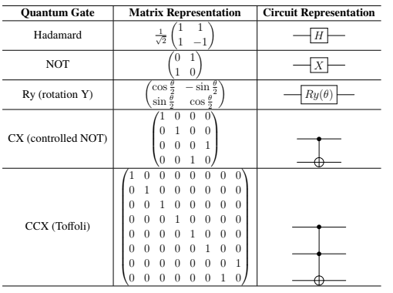
Background
Introduction & background
The Circuits
Data Encoding
Quantum
Run
Classical
Run
Results
Future
Work
Conclusion
Quantum gates
[6] S.U Sumsam (2019)
Trinity College Dublin, The University of Dublin
Notes:
Hadamard gate: One of the most frequently used quantum gate
gate. It puts a qubit in equal superposition of |0> and |1>. → turns a classical bit into a quantum bit
Toffoli: Toffoli or double controlled NOT gate is a 3 qubit gate, in which
two qubits act as control and the third qubit act as target. If both of the control
qubits are in state |1i then the target qubit is flipped and the control qubits
remain unchanged.
Controlled NOT: A controlled NOT gate is 2 qubit gate, where one qubit
acts as control and the other acts as target qubit. If the control qubit is in state
|1> the target qubit is flipped and the control qubit remains unchanged.
Rotation Y: Ry gate rotates the qubit along the y axis to the specified angle θ,
NOT: A quantum NOT gate flips the probabilities of state |0> and |1>
Need to include : SWAP gate

Slide 15
Circuitry
Introduction & background
The Circuits
Data Encoding
Quantum
Run
Classical
Run
Results
Future
Work
Conclusion
Quantum Circuits
Now we know what quantum gates look like.
Trinity College Dublin, The University of Dublin
Notes:
We know what quantum gates look like
What superposition is ana engalement

Slide 16
Circuitry
Introduction & background
The Circuits
Data Encoding
Quantum
Run
Classical
Run
Results
Future
Work
Conclusion
Quantum Circuits
Now we know what quantum gates look like.
❓❓Applications ❓❓
Trinity College Dublin, The University of Dublin

Slide 17
Circuitry
Introduction & background
The Circuits
Data Encoding
Quantum
Run
Classical
Run
Results
Future
Work
Conclusion
Quantum Circuits
Now we know what quantum gates look like.
❓❓Applications ❓❓
First one would have to know what type of operation one would like to carry out.
Trinity College Dublin, The University of Dublin

Slide 18
Circuitry
Introduction & background
The Circuits
Data Encoding
Quantum
Run
Classical
Run
Results
Future
Work
Conclusion
Quantum Circuits
Now we know what quantum gates look like.
❓❓Applications ❓❓
First one would have to know what type of operation one would like to carry out.
Machine Learning Algorithm: SVM, KNN
Search Algorithm: Grovers
Trinity College Dublin, The University of Dublin

Slide 19
Circuitry
Introduction & background
The Circuits
Data Encoding
Quantum
Run
Classical
Run
Results
Future
Work
Conclusion
Quantum K Nearest Neighbor
Trinity College Dublin, The University of Dublin
Notes:
KNN is a supervised learning algorithm used for classification and regression problem.
It makes predictions by learning from the past available data.
KNN Algorithm is based on feature similarity
Now we’ll break down each component and explore it further

Slide 20
Circuitry
Introduction & background
The Circuits
Data Encoding
Quantum
Run
Classical
Run
Results
Future
Work
Conclusion
Quantum K Nearest Neighbor
What: It is a supervised
Trinity College Dublin, The University of Dublin
Notes:
KNN is a supervised learning algorithm used for classification and regression problem.
It makes predictions by learning from the past available data.
KNN Algorithm is based on feature similarity
Now we’ll break down each component and explore it further

Slide 21
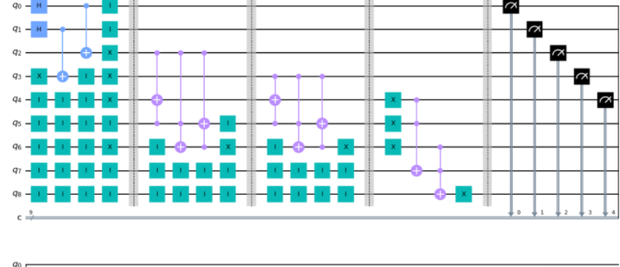
Circuitry
Introduction & background
The Circuits
Data Encoding
Quantum
Run
Classical
Run
Results
Future
Work
Conclusion
Quantum K Nearest Neighbor
What: It is a supervised
What it looks like for quantum
Trinity College Dublin, The University of Dublin
Notes:
Now we can see what it looks like for quanum computers
Now we’ll break down each component and explore it further
We will put all our gates into superspotsion
Then apply to additions
Then an OR operatioo

Slide 22
Circuitry
Introduction & background
The Circuits
Data Encoding
Quantum
Run
Classical
Run
Results
Future
Work
Conclusion
Quantum K Nearest Neighbor
Note: I will be following the guidance of Nathan.W, Ashish.K and Krysta.S and their work in Quantum algorithms for nearest-neighbor methods for supervised and unsupervised learning.
Specifically their
Hamming Distance: it is defined as counting the number of which the corresponding symbols of a two bit vectors of equal length are different e.g
Hamming Distance:( 0110 ← → 0001) has a distance of 3
Hamming Distance:( 0110 ← → 1110) has a distance of 1
Trinity College Dublin, The University of Dublin
Notes:
Just some house keeping ..
Hamming Distance : metric the use for measuring similarity. It’s just a traditional XOR

Slide 23
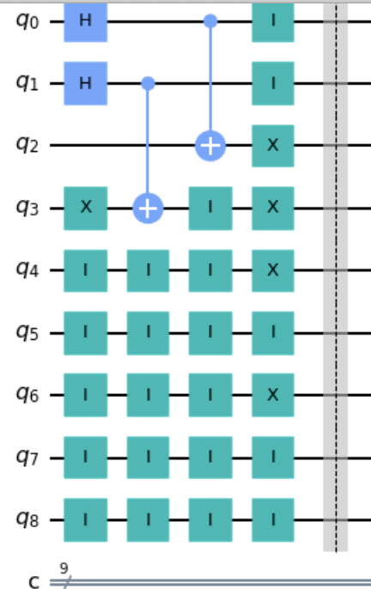
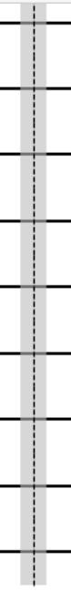
Circuitry
Introduction & background
The Circuits
Data Encoding
Quantum
Run
Classical
Run
Results
Future
Work
Conclusion
Quantum K Nearest Neighbor
Taking the first section, using the break after to identify the subsections.
Trinity College Dublin, The University of Dublin

Slide 24
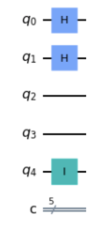

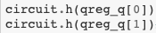
Circuitry
Introduction & background
The Circuits
Data Encoding
Quantum
Run
Classical
Run
Results
Future
Work
Conclusion
Quantum K Nearest Neighbor
Qubit 0 has the unclassified quantum state
Qubit 1 has the training set
With the ancillary bit being in the last register ( qubit 8)
Apply a Hammond gate to q0 and q1 , to put them into superposition.
Trinity College Dublin, The University of Dublin
Notes:
What the ID gate means ::
Now that we have put or training dtat an the qubit we will apply to the data into a quantum state

Slide 25
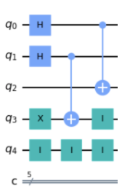
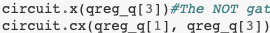

Circuitry
Introduction & background
The Circuits
Data Encoding
Quantum
Run
Classical
Run
Results
Future
Work
Conclusion
Quantum K Nearest Neighbor → Superposition & Entanglement
The CNOT is applied to Qubit 2 and Qubit 3 from each of the superposition elements in q0 and q1
This then entangles the gates
We will call the difference ‘D’
Trinity College Dublin, The University of Dublin
Notes:
We will now put them into superpsotion
Re-explain CNOT → acts on a pair of qubits, with one acting as ‘control’ ( q0 & q1)) and the
other as ‘target’. It performs a NOT on the target whenever the control is in state |1
***Say above after the first paragraph but before the entanglement ***
------------------------
*** Say below at end **
We are trying to mirror their states into the q2 and q3 that we will use later → we’ll call them d

Slide 26
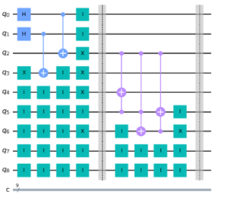
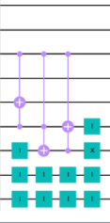
Circuitry
Introduction & background
The Circuits
Data Encoding
Quantum
Run
Classical
Run
Results
Future
Work
Conclusion
Quantum K Nearest Neighbor → Addition
We’re looking for a + d
We have d , Now need a

Slide 27
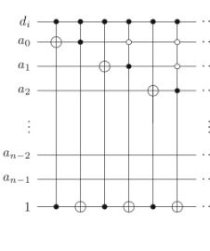
Circuitry
Introduction & background
The Circuits
Data Encoding
Quantum
Run
Classical
Run
Results
Future
Work
Conclusion
Quantum K Nearest Neighbor → First Addition
First we will see qubit 4 = A0
And qubit 5 = A1
D1 will the differences found in both qubit 2 and qubit 3
[1] P. Kaye, (Aug 2004)
Notes:
***Say below before begin ****
Following them same paper
We will first need to create and addition
With q2 and q3 being our d0 and d1
We will add a0+ a1 = d0 and a0+ a1 = d1
We will be following this design on the left
[1] P. Kaye, “Reversible addition circuit using one ancillary bit with application to quantum
computing,”

Slide 28
Circuitry
Introduction & background
The Circuits
Data Encoding
Quantum
Run
Classical
Run
Results
Future
Work
Conclusion
Quantum K Nearest Neighbor → First Addition
Taking qubit 2. The target is qubit 4 and the control is qubit 5
This time qubit 2 and 5 are the control and the target is qubit 6
Lastly qubit 5 is the target, with qubit 6 and 2 as the controls.
[1] P. Kaye, (Aug 2004)
4.) Negate Qubit 6 to find
the overflow
Notes:
$$ To:DO why we need the overflow
We are following the diagram on the left and putting it ito action
We will apply a Teoffli gate : two qubits act as control and the third qubit act as target.

Slide 29
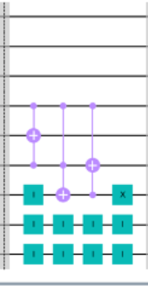




Circuitry
Introduction & background
The Circuits
Data Encoding
Quantum
Run
Classical
Run
Results
Future
Work
Conclusion
Quantum K Nearest Neighbor → Second Addition
[1] P. Kaye, (Aug 2004)
Notes:
$$ To:DO why we need the overflow
** Say at the beginning **
Now we repeat all the steps again but for the second addition with qubit 3
Taking qubit 2. The target is qubit 4 and the control is qubit 5
This time qubit 2 and 5 are the control and the target is qubit 6
Lastly qubit 5 is the target, with qubit 6 and 2 as the controls.
Negate qubit 6 to find the overflow

Slide 30
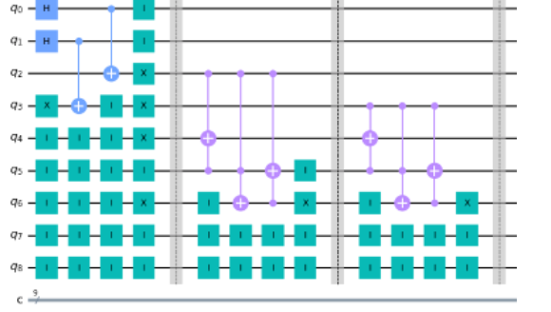
Circuitry
Introduction & background
The Circuits
Data Encoding
Quantum
Run
Classical
Run
Results
Future
Work
Conclusion
Quantum K Nearest Neighbor → Additions
Notes:
** Say at the beginning **
Now after the second we have the following circuit
Note : the breaks are used for clareity
** Say before moving to next slide *
With the addition done we now need find the condition of the hamming gate → next slide

Slide 31
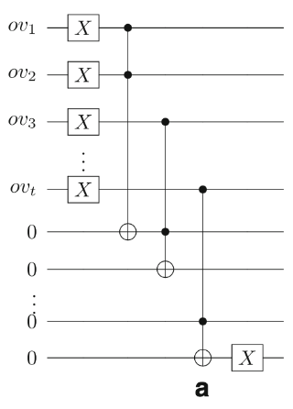
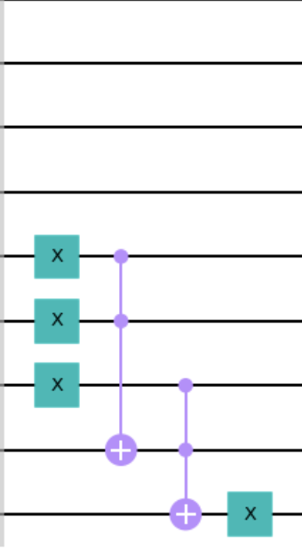
Circuitry
Introduction & background
The Circuits
Data Encoding
Quantum
Run
Classical
Run
Results
Future
Work
Conclusion
Quantum K Nearest Neighbor → Quantum OR
We need to first negate all inputs from our addition in qubits 4,5 and 6
This will make it easier to detect a zero or 1
[1] P. Kaye, (Aug 2004)
Notes:
Reminder what hamming distance is → to find the condition we perform a quantum OR gate on the most significant bit
If there is a zero or 1 → indicating a neighbour

Slide 32
Circuitry
Introduction & background
The Circuits
Data Encoding
Quantum
Run
Classical
Run
Results
Future
Work
Conclusion
Quantum K Nearest Neighbor → Quantum OR
Taking qubit 4 and 5. We apply a toffoli gate. With qubit 7 being the target
Then taking qubit 5 and 6. We apply another controlled controlled not gate. With qubit 8 as the target.
[1] P. Kaye, (Aug 2004)
Notes:
**Say before you bring up the slide contents ***
Reminder what hamming distance is → to find the condition we perform a quantum OR gate on the most significant bit
If there is a zero or 1 → indicating a neighbour
** Say after the left diagram **
Again We will be following this design on the left
[1] P. Kaye, “Reversible addition circuit using one ancillary bit with application to quantum
Computing,”
** Say at the end **
Reiterate the toffoli idea
Also why we negate at the end

Slide 33
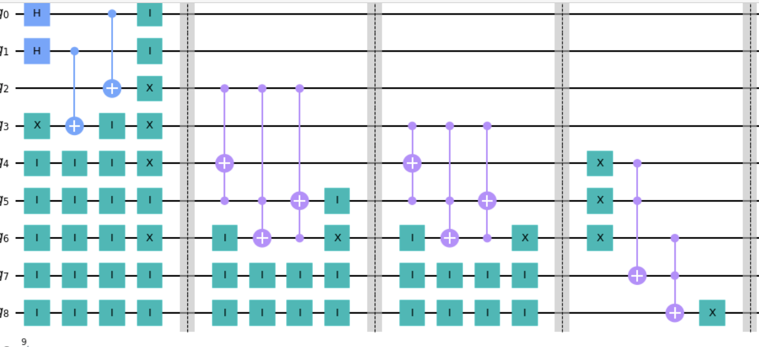
Circuitry
Introduction & background
The Circuits
Data Encoding
Quantum
Run
Classical
Run
Results
Future
Work
Conclusion
Quantum K Nearest Neighbor → Complete
Notes:
Thus Completing our KNN Circuit
Upsdie for quantum KNN is that
With classical KNNthe larger the data set the slower
With Quantum K Nearest Neighbour we’re placing the actual training set
into superposition, so in one run we can calculate all distances between the input and the
entire training set.
So one would only need as much qubits as is needed to encode your entire training set.

Slide 34
Circuitry
Introduction & background
The Circuits
Data Encoding
Quantum
Run
Classical
Run
Results
Future
Work
Conclusion
Support Vector Mechanism (SVM)
Notes:
Now that we know how to build a quantum circuit, using KNN as our example
We can apply it to another classification algorithm → SVM

Slide 35
Circuitry
Introduction & background
The Circuits
Data Encoding
Quantum
Run
Classical
Run
Results
Future
Work
Conclusion
Support Vector Mechanism (SVM)
Classical SVM
Supervised Learning used for classification
Classify : linearly separable datasets and non linearly separable datasets
Notes:
Two types of data that can be classified by this algorithms:

Slide 36
Circuitry
Introduction & background
The Circuits
Data Encoding
Quantum
Run
Classical
Run
Results
Future
Work
Conclusion
Quantum Support Vector Mechanism (SVM)
Quantum SVM
The quantum version of the SVM is best described as “quantum-assisted” or “quantum-enhanced” [7] in the sense that the algorithm is largely classical with certain operations performed by a quantum processor (real or simulated).
In the case of a quantum SVM we will only used the quantum feature maps to translate the classical data into quantum states and build the Kernel of the SVM out of these quantum states. After calculating the Kernel matrix on the quantum computer we can train the Quantum SVM the same way as the classical SVM.
Notes:
The idea of the quantum kernel is exactly the same as in the classical case. We take the inner product

Slide 37
Circuitry
Introduction & background
The Circuits
Data Encoding
Quantum
Run
Classical
Run
Results
Future
Work
Conclusion
Quantum Support Vector Mechanism (QSVM) → Implementation
Notes:
There are two ways to go about implementing QSVM

Slide 38
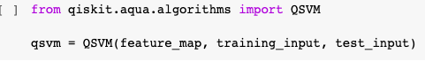
Circuitry
Introduction & background
The Circuits
Data Encoding
Quantum
Run
Classical
Run
Results
Future
Work
Conclusion
Quantum Support Vector Mechanism (SVM) → Implementation
There are two ways to go about implementing QSVM
In built Qiskit function
Notes:
Qiskit aqua also provides a pre-defined function to train the whole QSVM. Where we only have to provide the feature map, a training and a test set and Qiskit will do all the work for us.
Apart from finding the quantum Kernel the QSVM algorithm does only classical optimization. In the end there is no difference to the classical SVM, except that the Kernels are coming from a quantum distribution.
QSVM will minimize the loss via optimizing the parameters .
After training we can predict a label of a data instance with

Slide 39
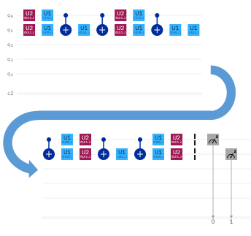
Circuitry
Introduction & background
The Circuits
Data Encoding
Quantum
Run
Classical
Run
Results
Future
Work
Conclusion
Quantum Support Vector Mechanism (SVM) → Implementation
There are two ways to go about implementing QSVM
In built Qiskit function
Build out the quantum circuit
[2] P.A McRae , M. Hilkea M (Dec 2020)
Notes:
There are two w ways to go about implementing QSVM
Qiskit aqua also provides a pre-defined function to train the whole QSVM. Where we only have to provide the feature map, a training and a test set and Qiskit will do all the work for us.
Apart from finding the quantum Kernel the QSVM algorithm does only classical optimization. In the end there is no difference to the classical SVM, except that the Kernels are coming from a quantum distribution.
QSVM will minimize the loss via optimizing the parameters .
There is no real benefit for quantum

Slide 40
Circuitry
Introduction & background
The Circuits
Data Encoding
Quantum
Run
Classical
Run
Results
Future
Work
Conclusion
Quantum Support Vector Mechanism (SVM) → Implementation
Notes:
We can start with the built in qiskit function
Qiskit aqua provides a pre-defined function to train the whole QSVM
It only requires an import
Then it requires feature map , which helps data encoding → which we discuss more about a little later on
Inally the testuign data

Slide 41
Circuitry
Introduction & background
The Circuits
Data Encoding
Quantum
Run
Classical
Run
Results
Future
Work
Conclusion
Quantum Support Vector Mechanism (SVM) → Implementation
[2] P.A McRae , M. Hilkea M (Dec 2020)
Notes:
The circuit on the other hand, is composed of utertar gates and CNot gates
Explain what they are
From P.A McRae , M. Hilkea M (Dec 2020) → Quantum-Enhanced Machine Learning for Covid-19 and
Anderson Insulator Predictions
They show ( then say above)

Slide 42
Circuitry
Introduction & background
The Circuits
Data Encoding
Quantum
Run
Classical
Run
Results
Future
Work
Conclusion
Quantum Support Vector Mechanism (SVM)
While QSVM, has been shown to minimize the loss
Apart from finding the quantum Kernel the QSVM algorithm does only classical optimization.
In the end there is no difference to the classical SVM, except that the Kernels are coming from a quantum distribution.
Notes:
“No real difference” ….→ or Quantum Advantage we can currently see

Slide 43
Circuitry
Introduction & background
The Circuits
Data Encoding
Quantum
Run
Classical
Run
Results
Future
Work
Conclusion
Grover's Quantum Search Algorithm
Notes:
Best example of showing quantum cabilites
However, even quadratic speedup is considerable when N is large.

Slide 44
Circuitry
Introduction & background
The Circuits
Data Encoding
Quantum
Run
Classical
Run
Results
Future
Work
Conclusion
Grover's Quantum Search Algorithm → What it is
Classically, searching an unsorted database requires a linear search, which is O(N) in time. Grover's algorithm, which takes O(N1/2) time, is the fastest possible quantum algorithm for searching an unsorted database.
It provides "only" a quadratic speedup, unlike other quantum algorithms, which can provide exponential speedup over their classical counterparts.
Notes:
**After last point ***
However, even quadratic speedup is considerable when N is large.

Slide 45
Circuitry
Introduction & background
The Circuits
Data Encoding
Quantum
Run
Classical
Run
Results
Future
Work
Conclusion
Grover's Quantum Search Algorithm → Implementation
Notes:
There are two different ways to implement SVM

Slide 46


Circuitry
Introduction & background
The Circuits
Data Encoding
Quantum
Run
Classical
Run
Results
Future
Work
Conclusion
Grover's Quantum Search Algorithm → Implementation
There are two ways to go about implementing QSVM
In built Qiskit function
Notes:
There are two different ways to implement SVM

Slide 47
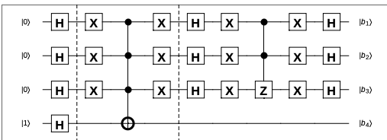
Circuitry
Introduction & background
The Circuits
Data Encoding
Quantum
Run
Classical
Run
Results
Future
Work
Conclusion
Grover's Quantum Search Algorithm → Implementation
There are two ways to go about implementing QSVM
In built Qiskit function
Build out the quantum circuit
[2] P.A McRae , M. Hilkea M (Dec 2020)
Notes:
Only downfall is that they don’t test it in real life but we will see it in action for a satisfiability problem

Slide 48
Circuitry
Introduction & background
The Circuits
Data Encoding
Quantum
Run
Classical
Run
Results
Future
Work
Conclusion
Grover's Quantum Search Algorithm → Implementation

Slide 49
Circuitry
Introduction & background
The Circuits
Data Encoding
Quantum
Run
Classical
Run
Results
Future
Work
Conclusion
Grover's Quantum Search Algorithm → Implementation
[3] P.A McRae , M. Hilkea M (Dec 2020)
Notes:
With 3 qubits and only one iteration
Multiple iterations could be used in reinforcement learning
Like all quantum computer algorithms, Grover's algorithm is probabilistic, in the sense that it gives the correct answer with high probability. The probability of failure can be decreased by repeating the algorithm

Slide 50
Data Encoding
Introduction & background
The Circuits
Data Encoding
Quantum
Run
Classical
Run
Results
Future
Work
Conclusion

Slide 51
Data Encoding
Introduction & background
The Circuits
Data Encoding
Quantum
Run
Classical
Run
Results
Future
Work
Conclusion
Now we know what quantum gates look like , how they look like in circuits.

Slide 52
Data Encoding
Introduction & background
The Circuits
Data Encoding
Quantum
Run
Classical
Run
Results
Future
Work
Conclusion
Now we know what quantum gates look like , how they look like in circuits.
How do we get classical data to run on a quantum circuit

Slide 53
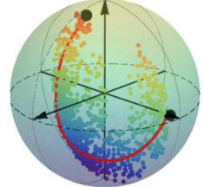
Data Encoding
Introduction & background
The Circuits
Data Encoding
Quantum
Run
Classical
Run
Results
Future
Work
Conclusion
Amplitude Encoding
Using a bloch sphere
Feature mapping
Notes:
There are a few ways to do about data encoding
While all of them are possible
We will only be looking at
Explain: briefly each

Slide 54
Data Encoding
Introduction & background
The Circuits
Data Encoding
Quantum
Run
Classical
Run
Results
Future
Work
Conclusion
Amplitude Encoding
Using a bloch sphere
Feature mapping
Notes:
There are a few ways to do about data encoding
While all of them are possible
We will only be looking at
We will be talking and implementing angle encoding and Feature mapping
-- highlight those two

Slide 55
Data Encoding
Introduction & background
The Circuits
Data Encoding
Quantum
Run
Classical
Run
Results
Future
Work
Conclusion
Amplitude Encoding

Slide 56
Data Encoding
Introduction & background
The Circuits
Data Encoding
Quantum
Run
Classical
Run
Results
Future
Work
Conclusion
Amplitude Encoding → What it is
It is one way of encoding classical information into amplitudes of quantum states .

Slide 57
Data Encoding
Introduction & background
The Circuits
Data Encoding
Quantum
Run
Classical
Run
Results
Future
Work
Conclusion
Amplitude Encoding → What it is
It is one way of encoding classical information into amplitudes of quantum states .
1.) Mapping the coordinates of a vector into the values of the amplitudes of a quantum state.
2.) It requires the vector to be normalized and to have a power of two dimension

Slide 58
Data Encoding
Introduction & background
The Circuits
Data Encoding
Quantum
Run
Classical
Run
Results
Future
Work
Conclusion
Amplitude Encoding → Implementation: Data Preparation
Notes:
We use as an example the iris dataset.
This dataset is composed of 4 variables labelled -1 or 1.
We only keep as a feature the 2 first columns and transform the labels as 0 and 1
The data are then padded with constant values and renormalized to have a unitary vector.

Slide 59
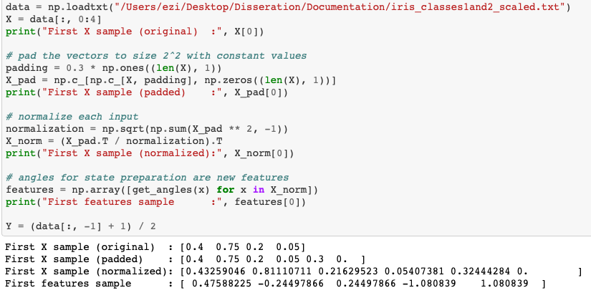
Data Encoding
Introduction & background
The Circuits
Data Encoding
Quantum
Run
Classical
Run
Results
Future
Work
Conclusion
Amplitude Encoding → Implementation: Data Preparation
Notes:
We use as an example the iris dataset.
This dataset is composed of 4 variables labelled -1 or 1.
We only keep as a feature the 2 first columns and transform the labels as 0 and 1
The data are then padded with constant values and renormalized to have a unitary vector.

Slide 60
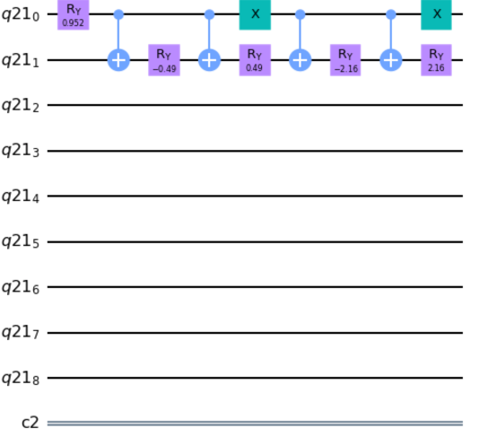
Data Encoding
Introduction & background
The Circuits
Data Encoding
Quantum
Run
Classical
Run
Results
Future
Work
Conclusion
Amplitude Encoding → Implementation: State Circuit
[4] M. Sawerwain,
M. Wroblewski (2019)
Notes:
Note : we need to initialise all other registers we will use later
Following RECOMMENDATION SYSTEMS WITH THE QUANTUM K–NN AND GROVER
ALGORITHMS FOR DATA PROCESSING
MAREK SAWERWAIN a,∗, MAREK WRÓBLEWSKI
We use a special routine to encode the data in the quantum circuit.
Ry → one of the Rotation operators. The Ry gate is a single-qubit rotation through angle θ (radians) around the y-axis.

Slide 61
Data Encoding
Introduction & background
The Circuits
Data Encoding
Quantum
Run
Classical
Run
Results
Future
Work
Conclusion
Feature Mapping
Notes:
With V(Φ(𝑥⃗)) , The V being the vector space
We can then map the vector space to
And we said how : Quantum states can also be noted in vector format. → how we talked about in amplitude encoding

Slide 62
Data Encoding
Introduction & background
The Circuits
Data Encoding
Quantum
Run
Classical
Run
Results
Future
Work
Conclusion
Feature Mapping
A Feature Map reduces the amount of resources required to describe a large set of data.
V(Φ(𝑥⃗)) is the parameterized circuit which converts the classical data to Quantum Data
Here Φ(…) is a classical function applied on a classical data
Notes:
With V(Φ(𝑥⃗)) , The V being the vector space
We can then map the vector space to
And we said how : Quantum states can also be noted in vector format. → how we talked about in amplitude encoding

Slide 63
Data Encoding
Introduction & background
The Circuits
Data Encoding
Quantum
Run
Classical
Run
Results
Future
Work
Conclusion
Feature Mapping → Types
Notes:
We will be making use of the last kind of feature map(ZFeatureMap). Mostly because it is the more simplistic of the two versions of the Pauli-Z evolution, however they are interchange code wise
But they are interchangeable code wise → some don’t work over others so just whichever works for you ( error free)

Slide 64
Data Encoding
Introduction & background
The Circuits
Data Encoding
Quantum
Run
Classical
Run
Results
Future
Work
Conclusion
Feature Mapping → Types
PauliFeatureMap
1. More general form of the feature map
2. It allows the user to create feature maps using different gates
ZZFeatureMap
Second-order Pauli-Z evolution circuit
ZFeatureMap
The first order Pauli Z-evolution circuit.
Notes:
We will be making use of the last kind of feature map(ZFeatureMap). Mostly because it is the more simplistic of the two versions of the Pauli-Z evolution, however they are interchange code wise
But they are interchangeable code wise → some don’t work over others so just whichever works for you ( error free)

Slide 65
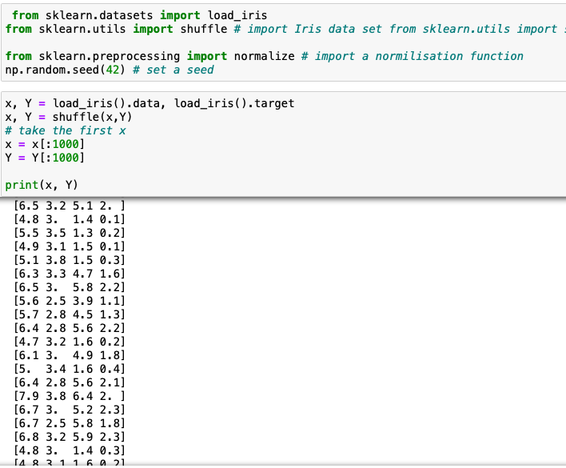
Data Encoding
Introduction & background
The Circuits
Data Encoding
Quantum
Run
Classical
Run
Results
Future
Work
Conclusion
Feature Mapping → Implementation: Data Preparation
Notes:
We use as an example the iris dataset. This dataset is composed of 4 variables labelled -1 or 1. We only keep as a feature the 2 first columns and transform the labels as 0 and 1
The data are then padded with constant values and renormalized to have a unitary vector.

Slide 66
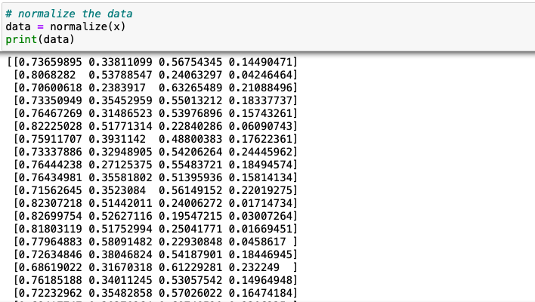
Data Encoding
Introduction & background
The Circuits
Data Encoding
Quantum
Run
Classical
Run
Results
Future
Work
Conclusion
Feature Mapping → Implementation: Data Preparation
Notes:
We use as an example the iris dataset. This dataset is composed of 4 variables labelled -1 or 1. We only keep as a feature the 2 first columns and transform the labels as 0 and 1
The data are then padded with constant values and renormalized to have a unitary vector.

Slide 67

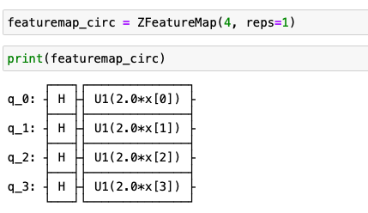

Data Encoding
Introduction & background
The Circuits
Data Encoding
Quantum
Run
Classical
Run
Results
Future
Work
Conclusion
Feature Mapping → Implementation: Circuit
Notes:
Now we can call on the mapping. First we import , we will import all 3 types of feature mapping
Then we can call it as a data frame, specifying the number of features and repetitions we would need. In our case 4 features, and only one repetitions.
Multiple repetitions will be useful for future neural network implementations
We will then assign the data to the circuit parameters

Slide 68
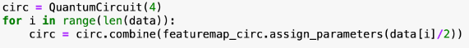
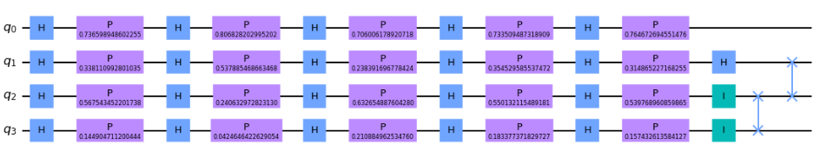
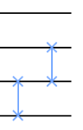
Data Encoding
Introduction & background
The Circuits
Data Encoding
Quantum
Run
Classical
Run
Results
Future
Work
Conclusion
Feature Mapping → Implementation: Circuit
Notes:
Following which we will combine the feature map circuit with assigned parameters of the second datapoint
We will need to loop and apply a and b do this for all data points , resulting in;
Now we will need a SWAP gate between them in order to
KNN implementation, the data is stored in qubit 1. In order to reduce our circuit and ensure all data points are encoded into qubit 1, we will make use of a SWAP Gate.
As illustrated in the image above, SWAP gates allow us to move information around in a quantum computer.
With this, we can combine the features mapped in qubit 3 with that in qubit 2, then combine that into qubit 1.

Slide 69
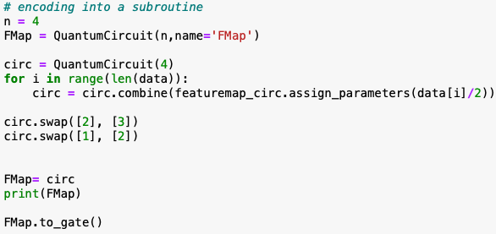
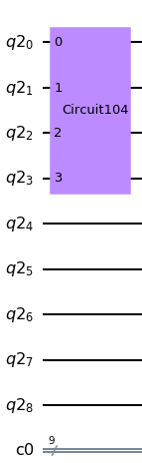
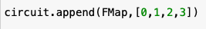
Data Encoding
Introduction & background
The Circuits
Data Encoding
Quantum
Run
Classical
Run
Results
Future
Work
Conclusion
Notes:
Putting it all together
We will first wrap both the data encoding and the Knn in a subroutine for clarity
Define the circuit , giving it a name and the number of bits it will require
Using the Feature Mapping steps but replacing the instance of circuit with FMap
Set it to gate that can be manipulated
Add our new formed subroutine to our current circuit, passing in the specified number of qubits as its parameters

Slide 70
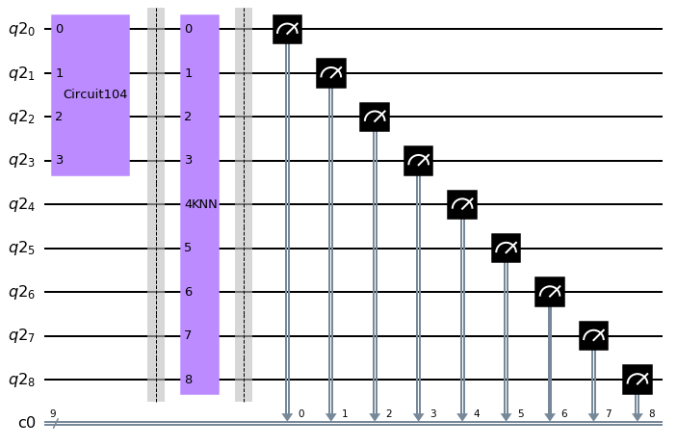
Data Encoding
Introduction & background
The Circuits
Data Encoding
Quantum
Run
Classical
Run
Results
Future
Work
Conclusion
Notes:
Putting it all together
This is our circuit output

Slide 71

Running on a Quantum Machine
Introduction & background
The Circuits
Data Encoding
Quantum
Run
Classical
Run
Results
Future
Work
Conclusion
Taking measurements
Notes:
Measuring
Think Schrödinger’s cat, which can be dead or alive with some probability. Opening the box is “measuring” the state of the cat.
In order to run the circuit we must first take measurements of each qubit. → force it to reveal it’s state

Slide 72

Running on a Quantum Machine
Introduction & background
The Circuits
Data Encoding
Quantum
Run
Classical
Run
Results
Future
Work
Conclusion
Taking measurements
Notes:
Measuring
This will enable us to see the overflow in qubit 8, hence telling if a given entry is in the test
set thus being a neighbour

Slide 73
Running on a Quantum Machine
Introduction & background
The Circuits
Data Encoding
Quantum
Run
Classical
Run
Results
Future
Work
Conclusion
IBM Quantum Computer → Setup
Notes:
We can first run it on a simulator to ensure no “error running jobs”.
With the simulator, like the quantum system, we can define how many shots we want.
Since qubits in superposition are random(sometimes 0,sometimes 1,or both), shots allow us to
repeat measurements multiple times to determine the likelihood it is in a particular state.
From there we can plot the results → we will see that visualisation soon

Slide 74
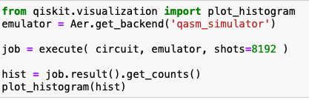
Running on a Quantum Machine
Introduction & background
The Circuits
Data Encoding
Quantum
Run
Classical
Run
Results
Future
Work
Conclusion
IBM Quantum Computer → Simulation
Notes:
We can first run it on a simulator to ensure no “error running jobs”.
With the simulator, like the quantum system, we can define how many shots we want.
Since qubits in superposition are random(sometimes 0,sometimes 1,or both), shots allow us to
repeat measurements multiple times to determine the likelihood it is in a particular state.
From there we can plot the results → we will see that visualisation soon

Slide 75
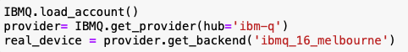
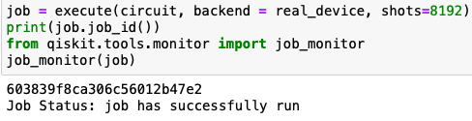
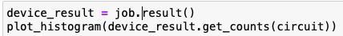
Running on a Quantum Machine
Introduction & background
The Circuits
Data Encoding
Quantum
Run
Classical
Run
Results
Future
Work
Conclusion
IBM Quantum Computer → Setup
Notes:
Now with it being error free, we can run it on the quantum system.
First we chose a quantum system with enough qubits for our circuit.
With how big our circuit is
Then execute the run job on the chosen system
From there we can again plot a histogram to visualise the result.

Slide 76
Running on a Quantum Machine
Introduction & background
The Circuits
Data Encoding
Quantum
Run
Classical
Run
Results
Future
Work
Conclusion
Classical Quantum Circuit
Notes:
Now that we how to run it on the IBM quantum experience
We would wants to compare it to the classical simulation

Slide 77
Running on a Quantum Machine
Introduction & background
The Circuits
Data Encoding
Quantum
Run
Classical
Run
Results
Future
Work
Conclusion
Classical Quantum Circuit → JKU Simulator: Background
Qiskit is designed to include third-party simulators contributed by the quantum community at large.
A prime example of such a simulator is the one created by Alwin Zulehner and Robert Wille from the quantum computation team at Johannes Kepler University in Linz, Austria.[5]
Notes:
Now that we how to run it on the IBM quantum experience
We would wants to compare it to the classical simulation

Slide 78
Running on a Quantum Machine
Introduction & background
The Circuits
Data Encoding
Quantum
Run
Classical
Run
Results
Future
Work
Conclusion
Classical Quantum Circuit → JKU Simulator: Background
The JKU simulator stores quantum states using a data structure which is based on classical decision diagrams.
This representation is more complex than simply storing a state vector, but if the vector has regular multiplicities, then it results in much more efficient storage space and manipulation time, while remaining able to deal with any quantum circuit, not limited, e.g., to Clifford gates.

Slide 79
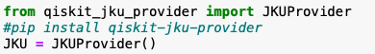
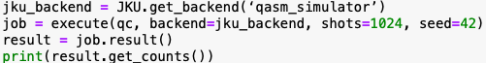
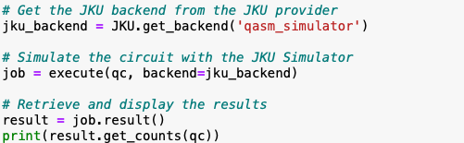
Running on a Quantum Machine
Introduction & background
The Circuits
Data Encoding
Quantum
Run
Classical
Run
Results
Future
Work
Conclusion
Classical Quantum Circuit → JKU Simulator: Implementation
Notes:
1.) First we import the tools
2.) Create an instance of the JKU Provider
3.) Get the JKU backend from the JKU provider
4.) Simulate the circuit with the JKU Simulator
5.) Retrieve and display the results

Slide 80
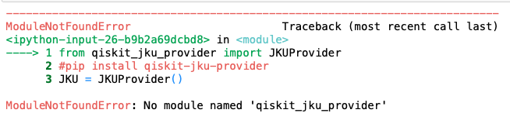
Running on a Quantum Machine
Introduction & background
The Circuits
Data Encoding
Quantum
Run
Classical
Run
Results
Future
Work
Conclusion
Classical Quantum Circuit → JKU Simulator
Notes:
Note: There are errors that will appear,

Slide 81
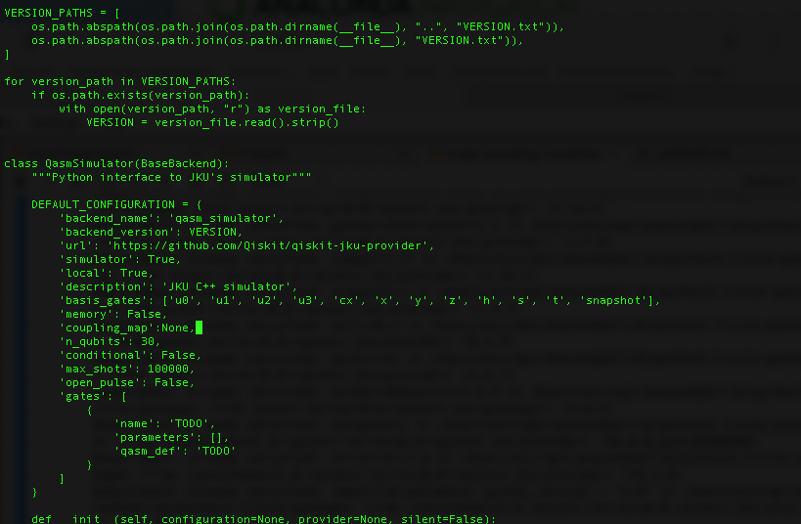
Running on a Quantum Machine
Introduction & background
The Circuits
Data Encoding
Quantum
Run
Classical
Run
Results
Future
Work
Conclusion
Classical Quantum Circuit → JKU Simulator
Notes:
To fix this you must find thee DEFAULT_CONFIGURATION of the QasmSimulator class in the file qasm_simulator_jku.py.
The include the line : 'coupling_map': None

Slide 82
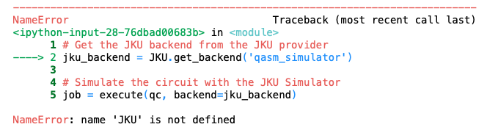
Running on a Quantum Machine
Introduction & background
The Circuits
Data Encoding
Quantum
Run
Classical
Run
Results
Future
Work
Conclusion
Classical Quantum Circuit → JKU Simulator: Errors
Notes:
Note: There’s a 2nd error that will come up
There is a fix in progress

Slide 83

Running on a Quantum Machine
Introduction & background
The Circuits
Data Encoding
Quantum
Run
Classical
Run
Results
Future
Work
Conclusion
Classical Quantum Circuit → JKU Simulator: Errors
Notes:
Note: There’s a 2nd error that will come up
There is a fix in progress

Slide 84
Results
Introduction & background
The Circuits
Data Encoding
Quantum
Run
Classical
Run
Results
Future
Work
Conclusion
Simulator vs Quantum Run
Quantum simulator is designed to simulate the idea quantum environnement without noise.
While the quantum Run on a quantum machine will have noise
Notes:
Now that we know to run our circuits on a quantum computer and what the future classical simulation looks like
Let’s now see what the quantum output would like like
→ Explain what a simulation run is vs a aunt um → most importantly noise
→ Simulation vs quantum run → KNN then grovers then svm : ~Explain the probabilities

Slide 85
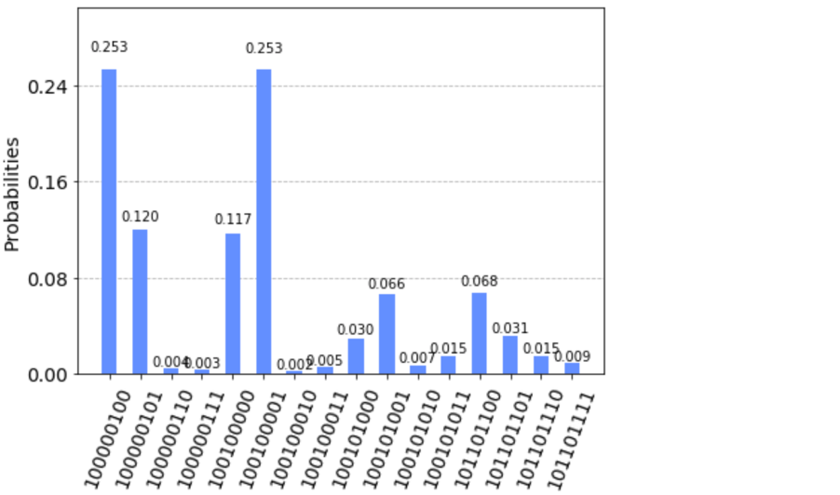
Results
Introduction & background
The Circuits
Data Encoding
Quantum
Run
Classical
Run
Results
Future
Work
Conclusion
Understanding The Results → KNN: Classical Simulation
Notes:
Taking KNN as an example we can see the
Simulation results above
IT is graphed against the probabilities vs the frequency
Each bar showing the probability of finding e.g ( the first oen) is at 0.253
Those with the same/ similar probabilities can be said to be neighbours
Remembering that we are taking the iris data set with 4 features , and looking for three groupings SETOSA, VERSICOLOR, VIRGINCA
While the accuracy is not as perfect, we can still see the 3 main four classifications at 0.253, 0.120-0.117 and 0.066-0.068.
For each type of flower

Slide 86
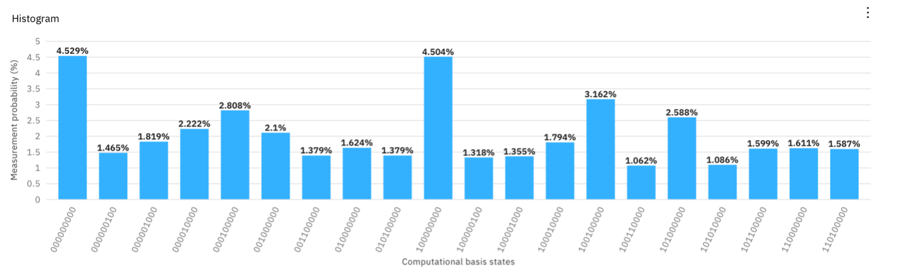
Results
Introduction & background
The Circuits
Data Encoding
Quantum
Run
Classical
Run
Results
Future
Work
Conclusion
Understanding The Results → KNN: Classical Simulation
Notes:
This illustrates the circuit run on a 16 qubit quantum system
While this has a lot more noise and without datt input of 10,000 it becomes slightly harder to read.
We can still see the groupings 45, 2% and the 1.%
Again we can mitigate nisei with a loweer sampel size but also increasing the shots

Slide 87
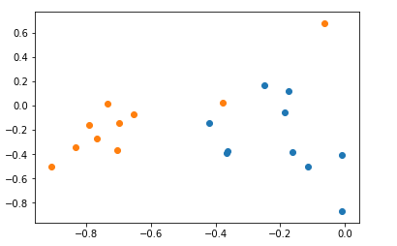
Results
Introduction & background
The Circuits
Data Encoding
Quantum
Run
Classical
Run
Results
Future
Work
Conclusion
Understanding The Results → Quantum SVM
Notes:
With SVm we will get a very similar result
Breast cancer data set to classify benign and malignant

Slide 88
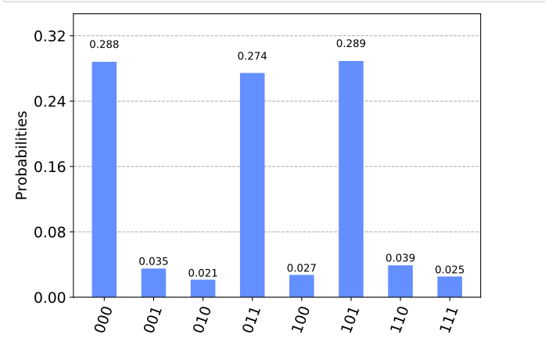
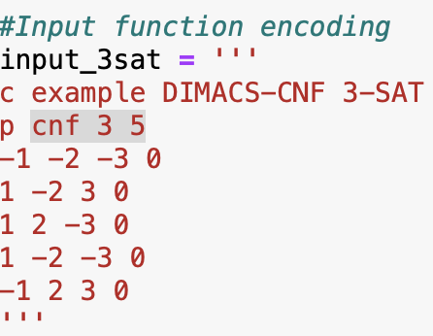
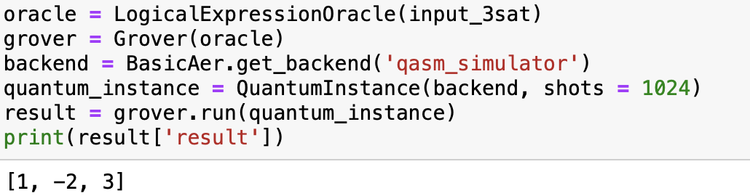
Results
Introduction & background
The Circuits
Data Encoding
Quantum
Run
Classical
Run
Results
Future
Work
Conclusion
Understanding The Results → Grover's Algorithm
Notes:
Simailry we can see it for Grovers algorhtm running on a example 3-Satisfiability (3-SAT)
The three results for the satisfiability problem are 000, 011, and 101.
A Boolean SAT problem is the problem of determining if there are certain inputs into a Boolean function such that the output is TRUE. This, among others, is a search problem, which is why Grover’s algorithm is great for solving them.

Slide 89
Future Work
Introduction & background
The Circuits
Data Encoding
Quantum
Run
Classical
Run
Results
Future
Work
Conclusion
Notes:
We now have a tool a modular took for quantum and quantum encased machine learning
Showing both SVM, KNN and grovers applcaitosns
Whats’s next ?
In teh short term: Expand the tool as a blackbox api
Expand it for a new input of k, with futhrur grouping

Slide 90


Future Work
Introduction & background
The Circuits
Data Encoding
Quantum
Run
Classical
Run
Results
Future
Work
Conclusion
Short Term
Notes:
We now have a tool a modular took for quantum and quantum encased machine learning
Showing both SVM, KNN and grovers applcaitosns
Whats’s next ?
In teh short term: Expand the tool as a blackbox api
Expand it for a new input of k, with futhrur grouping

Slide 91

Future Work
Introduction & background
The Circuits
Data Encoding
Quantum
Run
Classical
Run
Results
Future
Work
Conclusion
Long Term
Notes:
Even from there : USing reinforcement learning and/ or recommendation systems→
With grovers we can increase our count size when remeasuring
The inclusion of feature amplification

Slide 92

Future Work
Introduction & background
The Circuits
Data Encoding
Quantum
Run
Classical
Run
Results
Future
Work
Conclusion
Long Term
Notes:
Even from there : iUSinf reinforcmnt learning and/ ro recommendation systems→
With grovers we can increase our count size when remeausreing
Teh inclusion of feature amplitcaitn

Slide 93
Future Work
Introduction & background
The Circuits
Data Encoding
Quantum
Run
Classical
Run
Results
Future
Work
Conclusion
Long Term
No of Iterations : 1
Notes:
Even from there : iUSinf reinforcmnt learning and/ ro recommendation systems→
With grovers we can increase our count size when remeausreing
Teh inclusion of feature amplitcaitn

Slide 94

Future Work
Introduction & background
The Circuits
Data Encoding
Quantum
Run
Classical
Run
Results
Future
Work
Conclusion
Long Term
No of Iterations : 2
Notes:
Even from there : iUSinf reinforcmnt learning and/ ro recommendation systems→
With grovers we can increase our count size when remeausreing
Teh inclusion of feature amplitcaitn

Slide 95

Future Work
Introduction & background
The Circuits
Data Encoding
Quantum
Run
Classical
Run
Results
Future
Work
Conclusion
Long Term
Notes:
A new section would be the inclusion of amplitude amplification for the features selected

Slide 96
Conclusion
Introduction & background
The Circuits
Data Encoding
Quantum
Run
Classical
Run
Results
Future
Work
Conclusion

Slide 97

Conclusion
Introduction & background
The Circuits
Data Encoding
Quantum
Run
Classical
Run
Results
Future
Work
Conclusion

Slide 98
Conclusion
Introduction & background
The Circuits
Data Encoding
Quantum
Run
Classical
Run
Results
Future
Work
Conclusion

Slide 99
Conclusion
Introduction & background
The Circuits
Data Encoding
Quantum
Run
Classical
Run
Results
Future
Work
Conclusion
Notes:
And More

Slide 100
Conclusion
Introduction & background
The Circuits
Data Encoding
Quantum
Run
Classical
Run
Results
Future
Work
Conclusion
Notes:
And More Consumable
Quantum has a long way to go but it’s here and i’ts only going up

Slide 101
Thank You
Notes:
Any Questions ??

